Slide 1
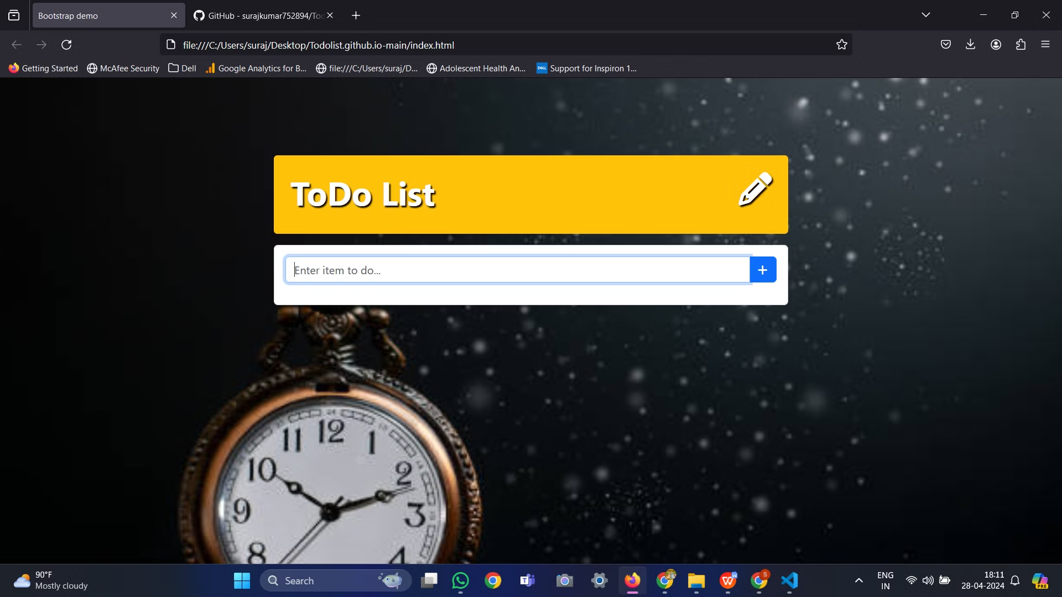


Title: Mastering Productivity: To-Do List Guide
Slide 1: Introduction
Welcome to "Mastering Productivity: The Ultimate To-Do List Guide"
Today, we'll explore strategies and techniques to optimize your to-do lists for maximum productivity.

Slide 2
The Power of To-Do Lists
Definition: What is a to-do list?
Benefits: Increased productivity, organization, stress reduction, and goal achievement.
Quote: "The secret of getting ahead is getting started." - Mark Twain

Slide 3
Types of To-Do Lists
Simple Checklist
Prioritized List
Time-Block Schedule
Kanban Board
Goal-Oriented List
🧑‍🚀

Slide 4
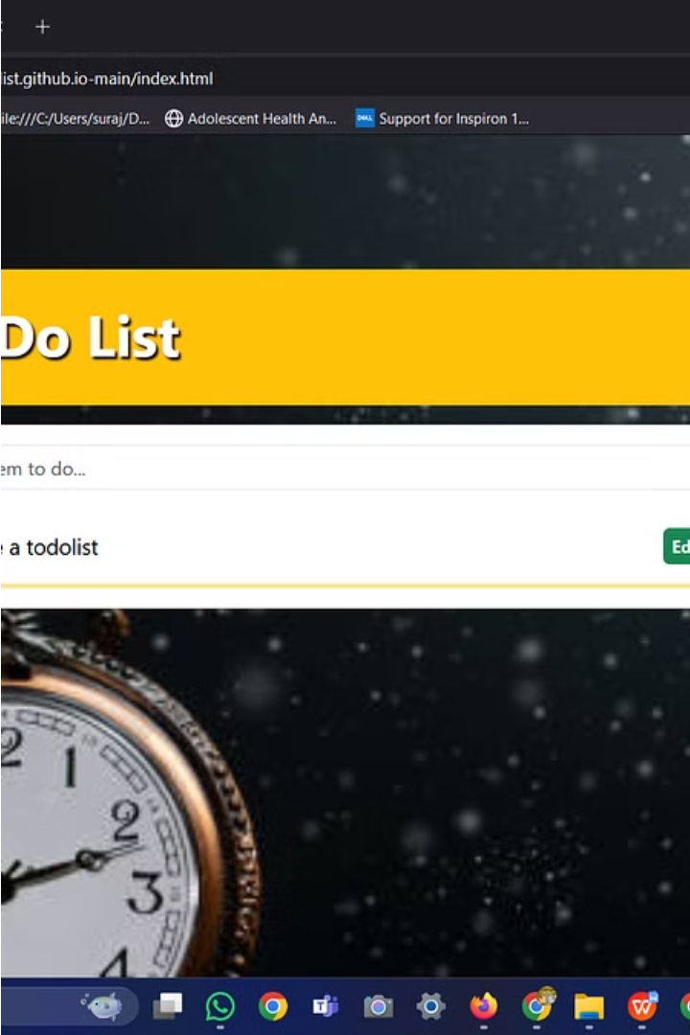
Creating an Effective To-Do List
Clear and Specific Tasks
Prioritize Tasks
Set Realistic Deadlines
Use Categories or Labels
Review and Update Regularly

Slide 5
Tools and Apps
Todoist
Trello
Microsoft To Do
Google Keep
Any.do
💡 Tip: Chunk up your content by nesting cards using /Nested card inside

Slide 6
Tips for Success
Start with the most important task.
Break tasks into smaller, manageable steps.
Avoid overloading your list.
Learn to say no.
Reward yourself for completing tasks.

Slide 7
Common Pitfalls to Avoid
Overcomplicating the list.
Procrastination.
Lack of flexibility.
Ignoring self-care tasks.
Not celebrating achievements.
💡

Slide 8
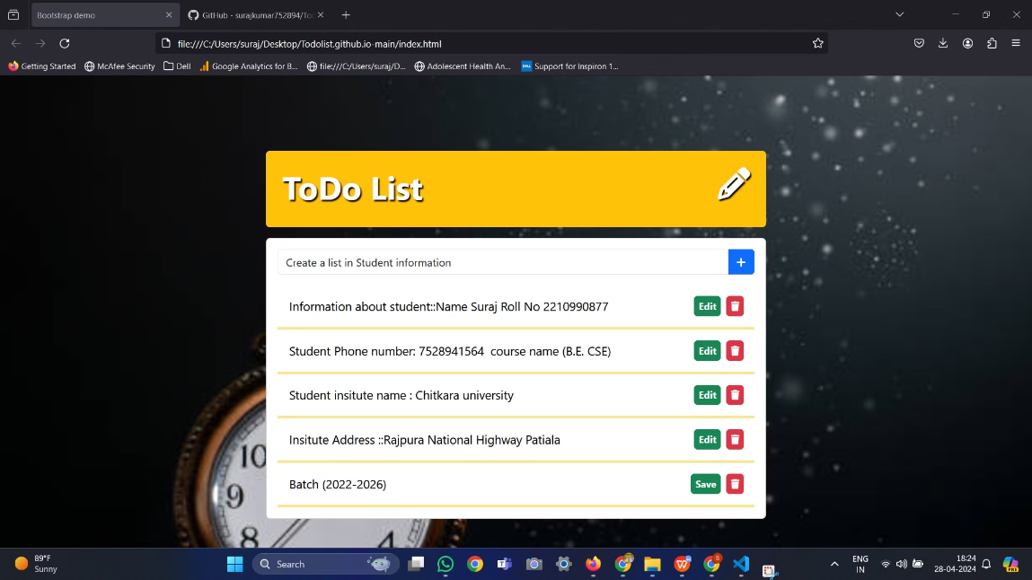
Case Study: Before and After
Present a real-life example of someone's to-do list before implementing strategies and after.
Highlight the improvements in productivity and organization.
💡

Slide 9
Conclusion
Recap the importance of to-do lists.
Encourage attendees to implement the strategies discussed.
Thank you for joining "Mastering Productivity: The Ultimate To-Do List Guide."

Slide 10

: Q&A
Open the floor for any questions or discussions.
Feel free to adjust the content and design to fit your presentation style and audience preferences!

